Slide 1

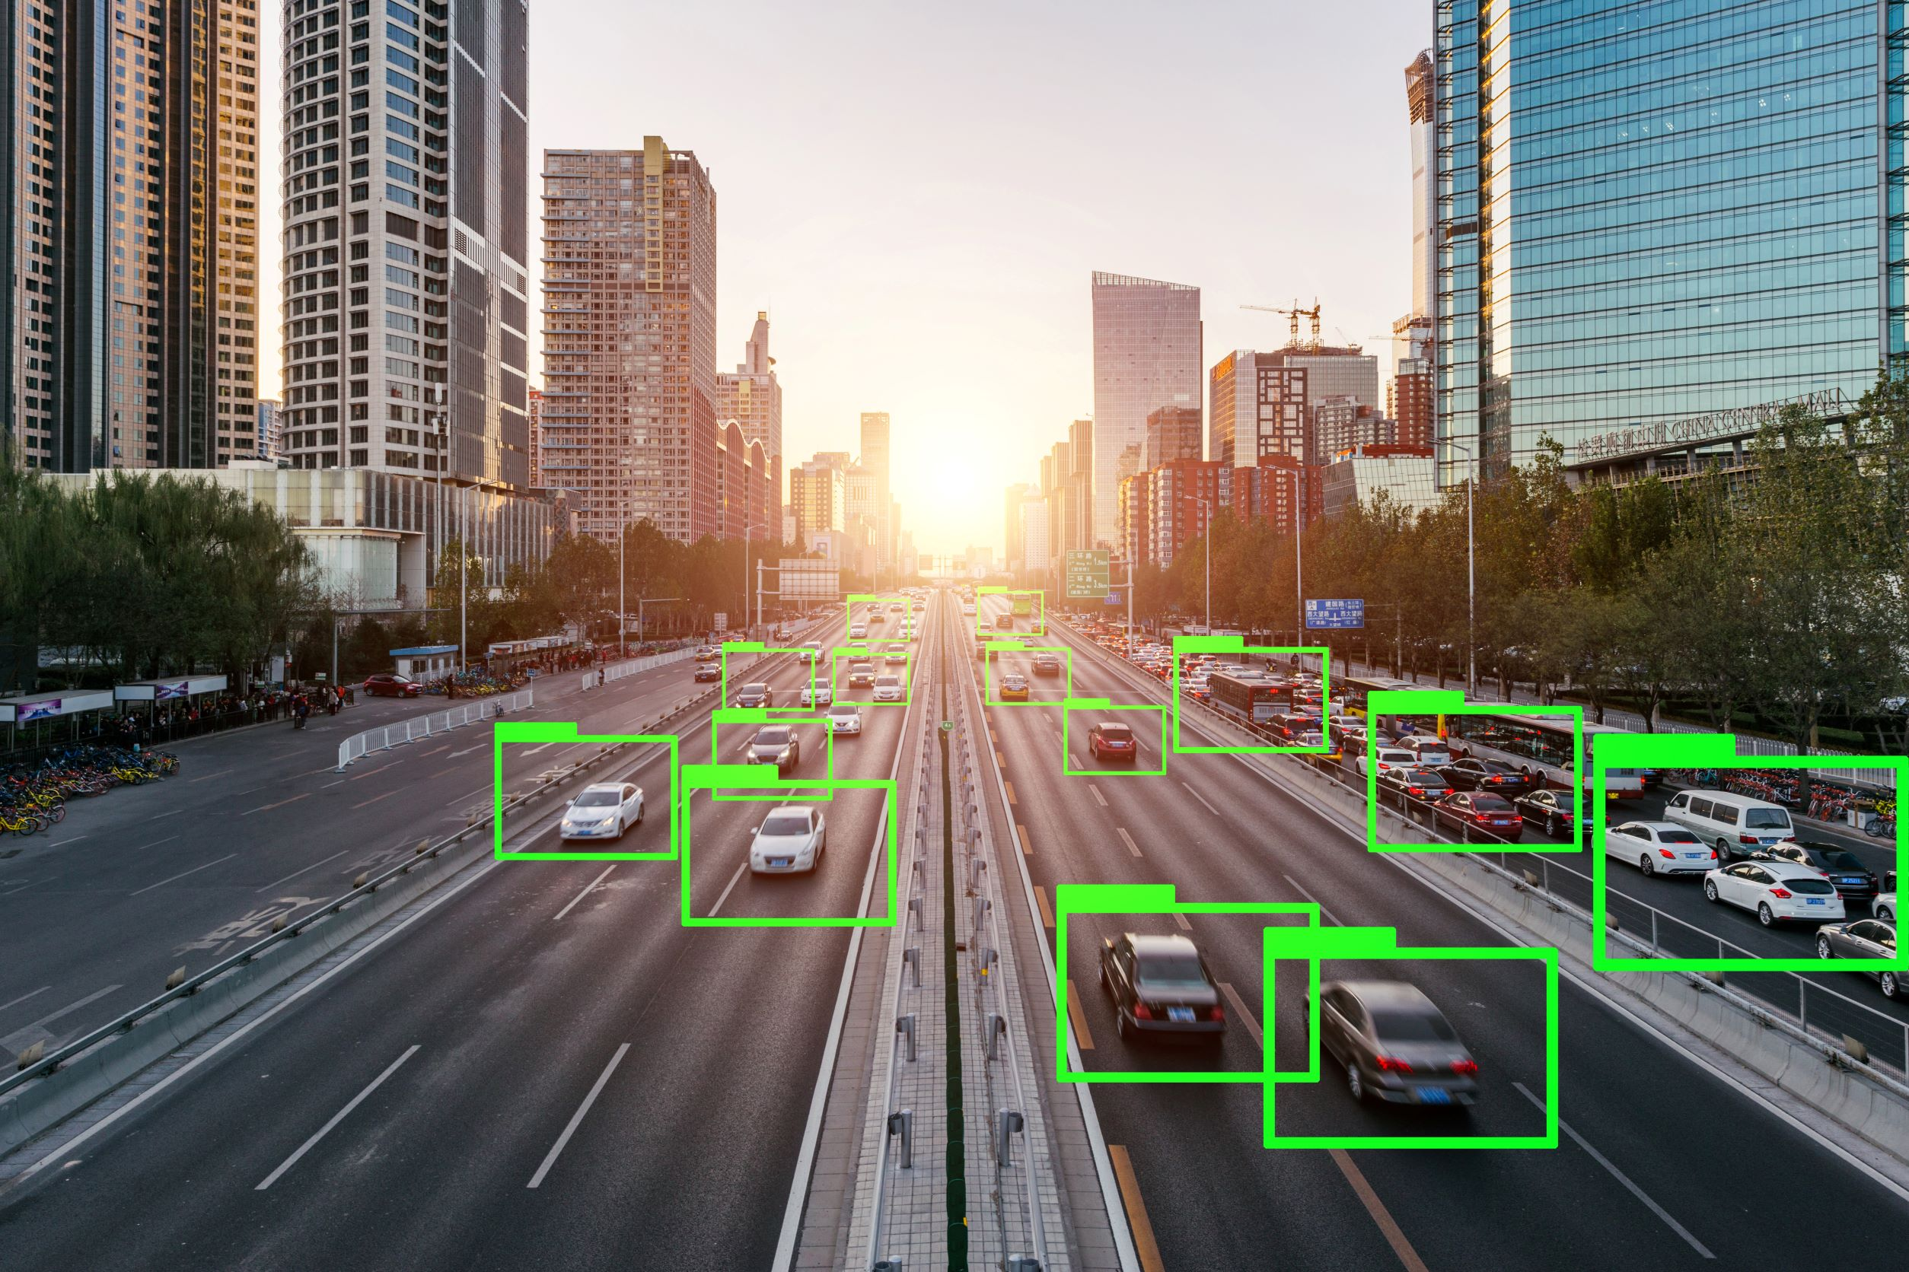
Vehicle Detection Project
01
28/12/2024

Slide 2
Project Overview
The Vehicle Detection Project utilizes the YOLO (You Only Look Once) model to detect and analyze vehicles in images and video streams.
The project involves data preparation, model training, and validation for traffic monitoring. Key features include detecting traffic density, identifying vehicle counts, and differentiating lanes to assess congestion levels.
The implementation also includes real-time video processing and visualization of results for practical applications in traffic management and smart city systems.
02

Slide 3


Problem Statement
The increasing volume of vehicles on roads has led to traffic congestion, accidents, and challenges in traffic management.
Manual methods for monitoring and analyzing vehicle flow are time-consuming and prone to errors. There is a need for an automated, real-time solution to detect vehicles, assess traffic density, and provide insights into road conditions.
This project addresses the problem by leveraging AI-based computer vision techniques to enhance traffic monitoring efficiency and support smart city initiatives.
03

Slide 4
Project workflow
Collecting dataset
Pre-training model
Training
Validation
openCV performing
Convert video
GUI show
04

Slide 5
Project workflow
Collecting dataset
Pre-training model
Training
Validation
openCV performing
Convert video
GUI show
https://www.kaggle.com/datasets/farzadnekouei/top-view-vehicle-detection-image-dataset
05

Slide 6
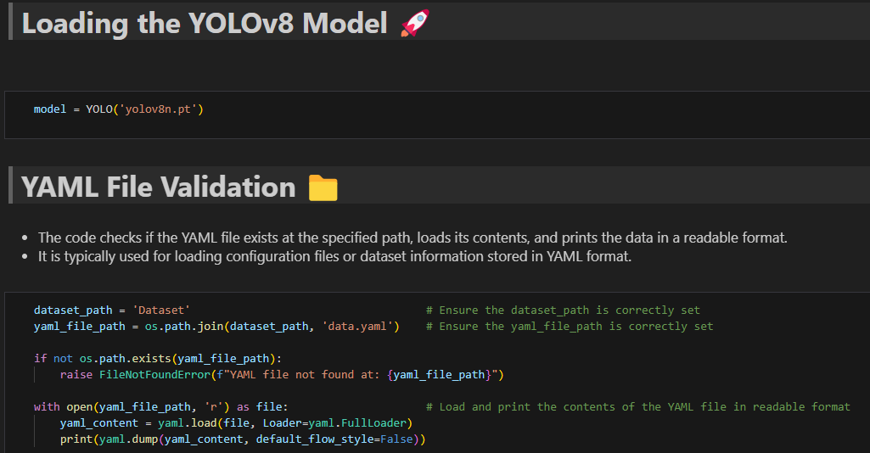
Project workflow
Collecting dataset
Pre-training model
Training
Validation
openCV performing
Convert video
GUI show
06

Slide 7
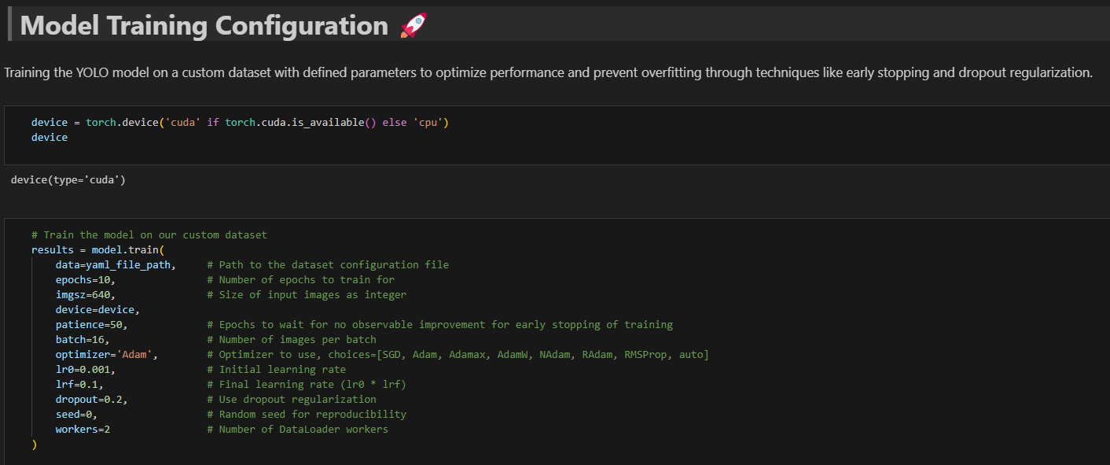
Project workflow
Collecting dataset
Pre-training model
Training
Validation
openCV performing
Convert video
GUI show
07

Slide 8
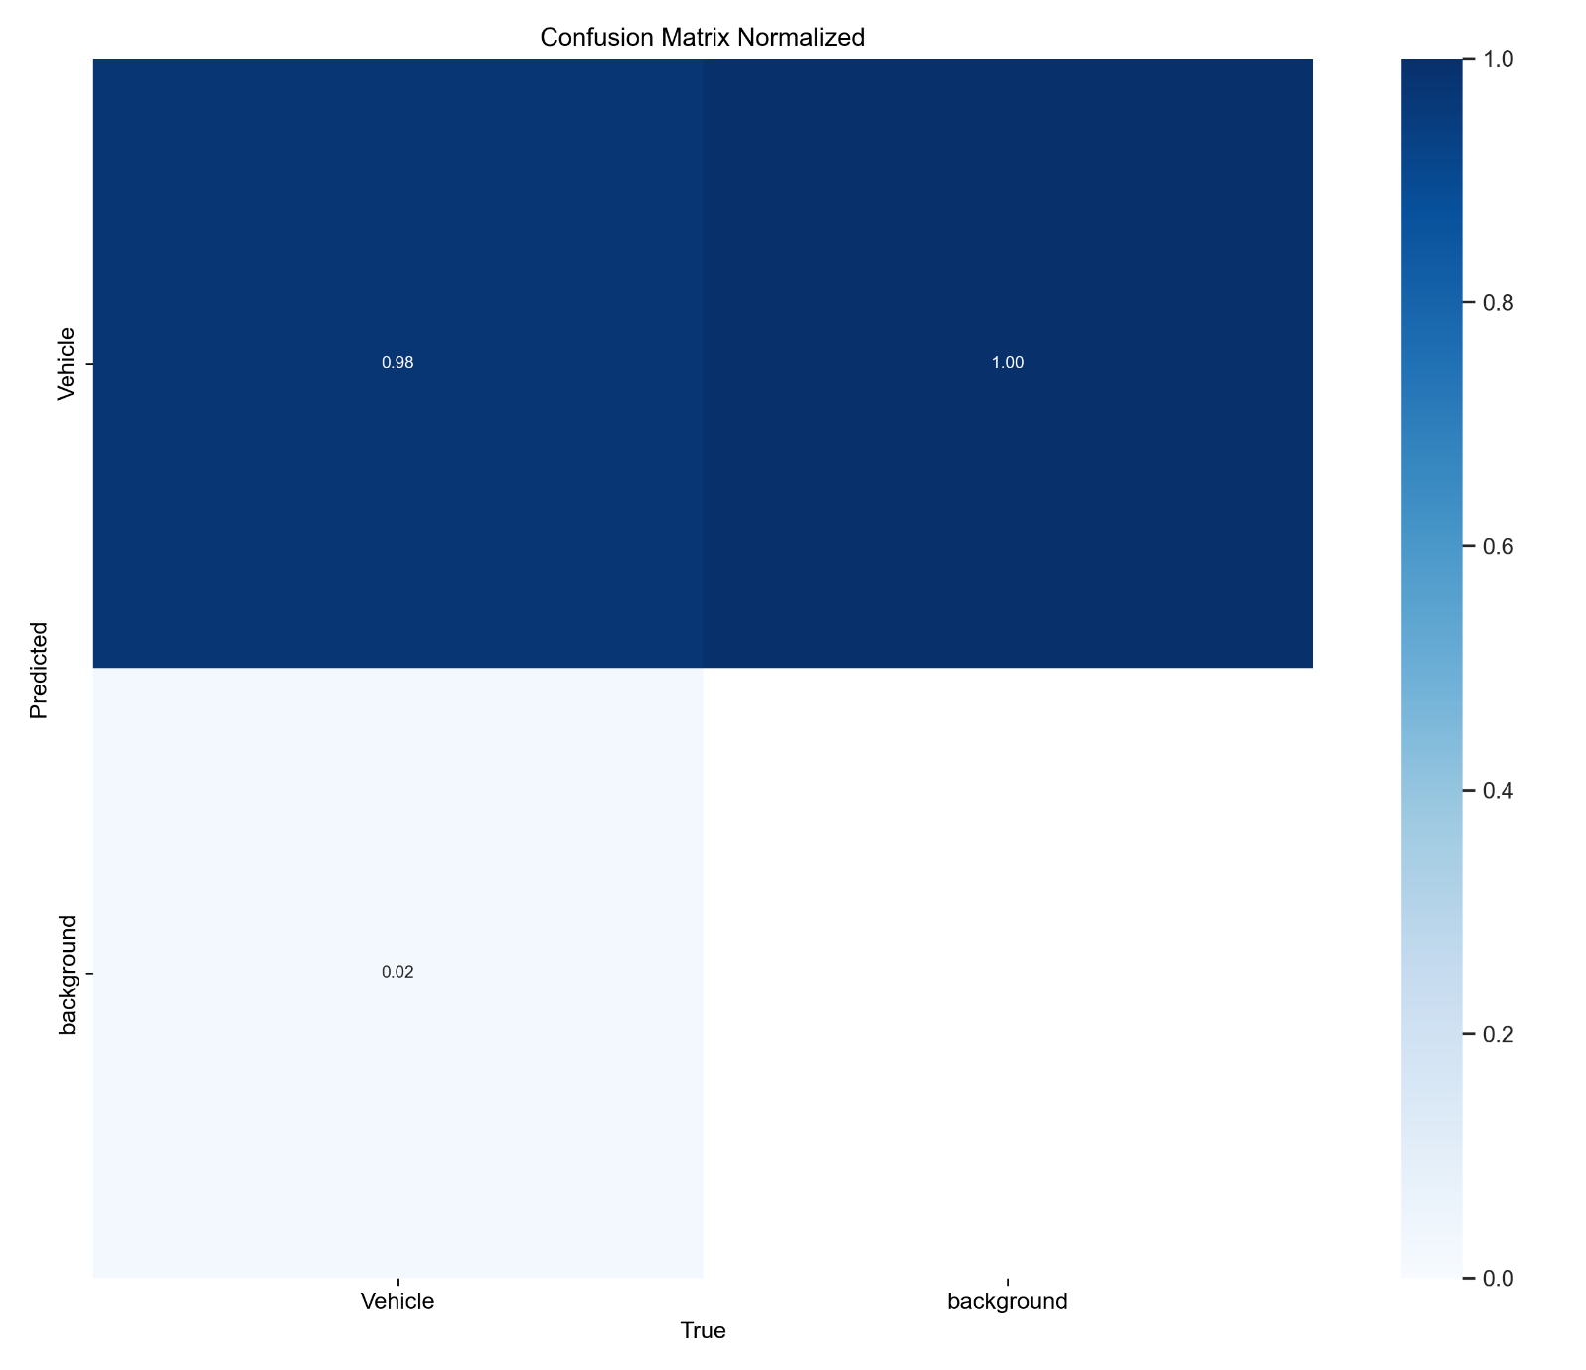
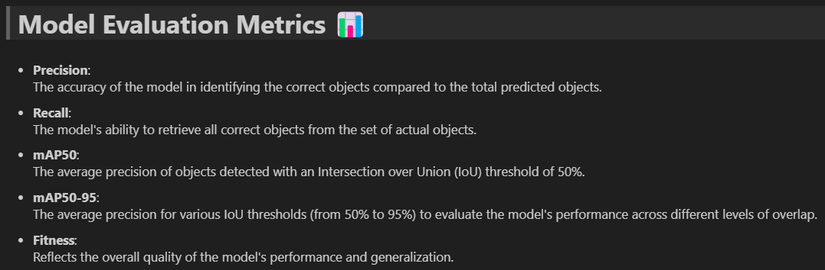
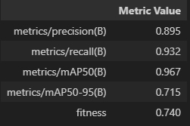
Project workflow
Collecting dataset
Pre-training model
Training
Validation
openCV performing
Convert video
GUI show
08

Slide 9
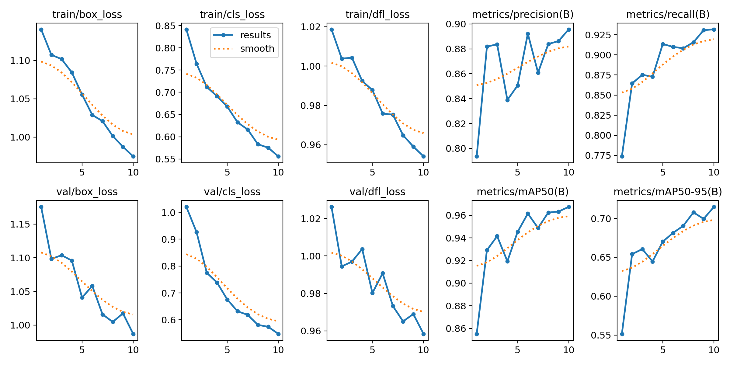
Plotting validation Curves
09

Slide 10
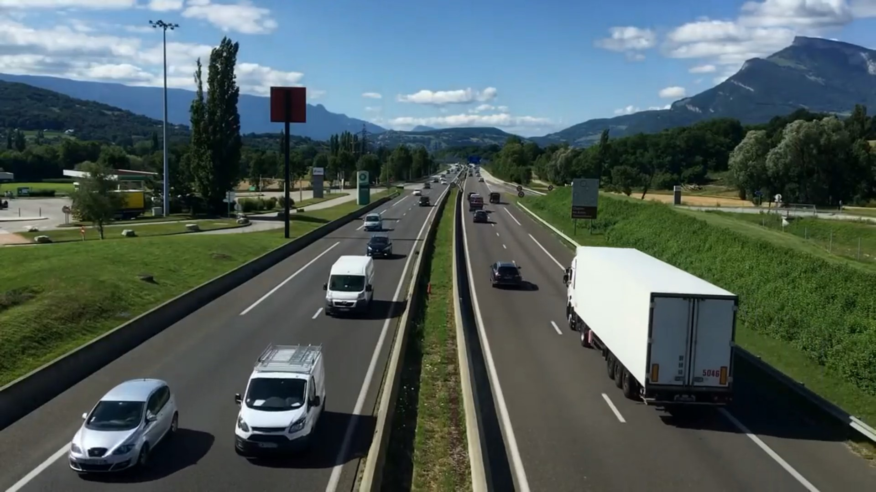
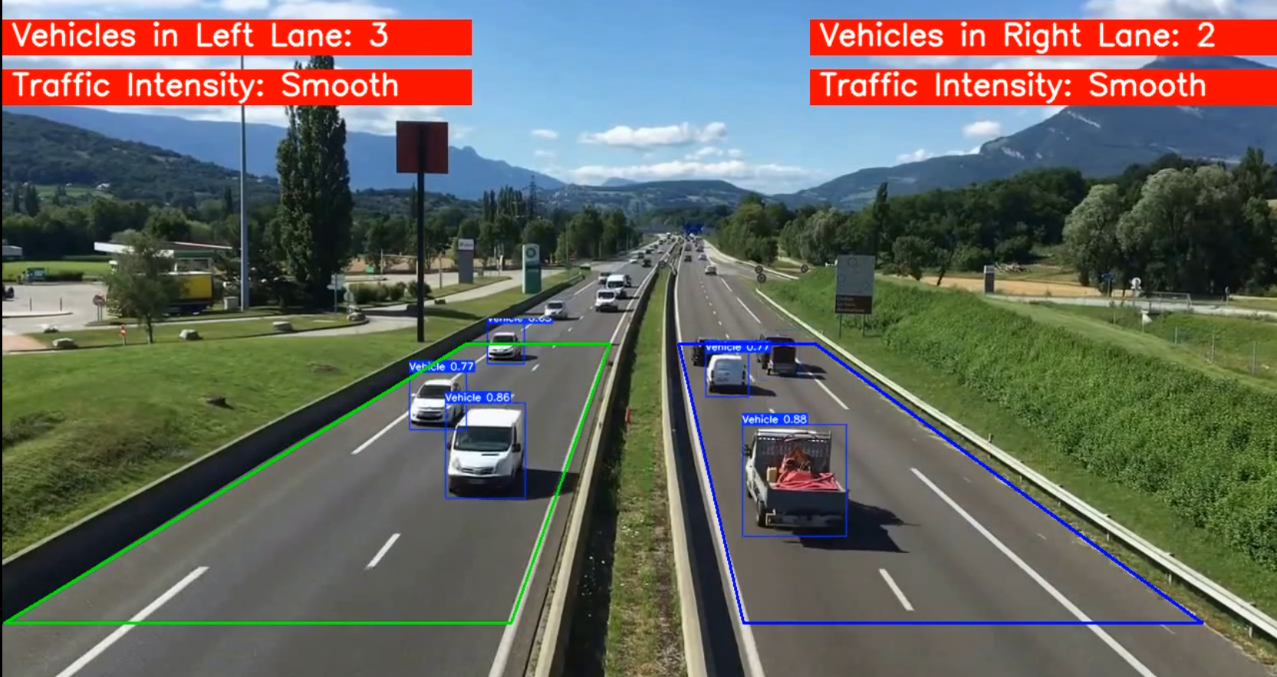
Project workflow
Collecting dataset
Pre-training model
Training
Validation
openCV performing
Convert video
GUI show
10

Slide 11
Thank You!
To: Eng. Omar Elnahas
Presented by:
Ahmed Abdellatif Amer
Abdalla Mohamed farag
Abdelrhman Ahmed Ezzat
Mohamed ali mohamed sharf
Mohamed Ahmed AbdelAzim
Hassan Abdelnasser Ahmed
Mohamed Ragab aboelfarh
Asem Ahmed Mohamed Fared
Abdelrahman Mohamed Abdelrahman
13

